Slide 1
Germany and WW2
Invasion of Poland / Blitzkrieg
‘Phoney War’
Fall of France and the Battle of Britain
Operation Barbarossa
Stalingrad
The final solution

Slide 2
Invasion of Poland / Blitzkrieg
What was the Blitzkrieg? https://www.youtube.com/watch?v=bClvk6T_CYQ
Blitzkrieg = lightning war
A military tactic designed to create disorganisation among enemy forces through the use of mobile forces and locally concentrated firepower.
Poland had received the former German provinces of West Prussia, Poznan, and Upper Silesia under the Treaty of Versailles.
On September 1, 1939, Germany invaded Poland. To justify the action, Nazi propagandists falsely claimed that Poland had been planning, with its allies Great Britain and France, to encircle and dismember Germany and that Poles were persecuting ethnic Germans.

Slide 3
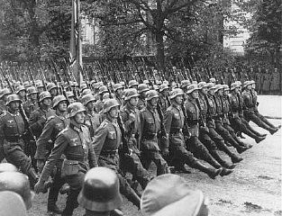
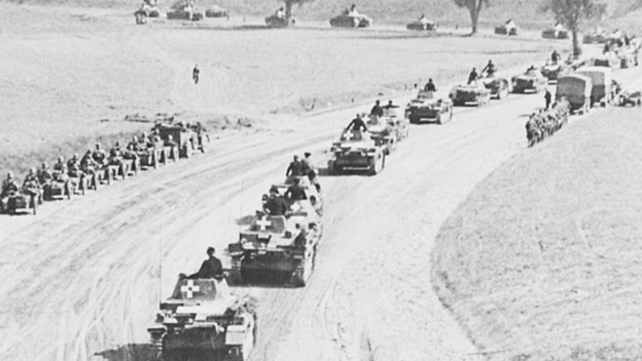

Slide 4
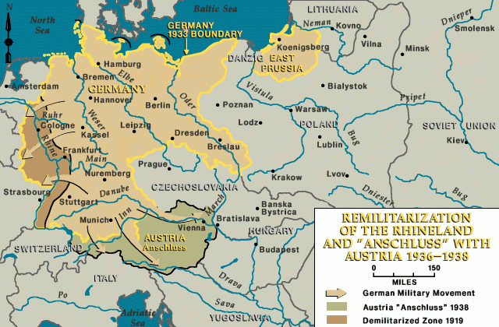

Slide 5
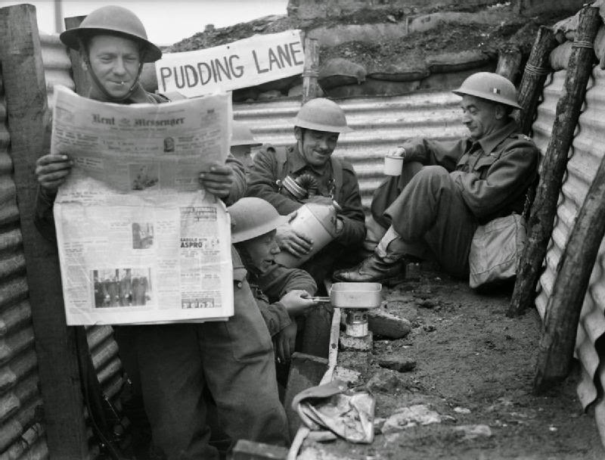
‘Phoney War’
The name given to the period of time in World War Two from September 1939 to April 1940 when, after the blitzkrieg attack on Poland in September 1939, seemingly nothing happened.
To assume that nothing was going on in Europe would be wrong as Poland was in the process of being occupied with all that brought for the Polish people. However, in Western Europe very little of military importance did take place.
British soldiers during the ‘Phony War’

Slide 6
Fall of France
On 10 May 1940, when Germany launched an invasion of France.
The German plan of attack, codenamed Case Yellow, entailed an armoured offensive through the Ardennes Forest, which bypassed the strong French frontier defences of the Maginot Line.
On 5 June, the Germans swung southwards and French resistance finally collapsed, although not without heavy fighting. On 10 June, Italy opportunistically entered the war on Germany's side. Four days later, the French capital fell, provoking the flight of the French Government to Bordeaux. The Government capitulated on 25 June, just seven weeks after the beginning of the invasion.

Slide 7
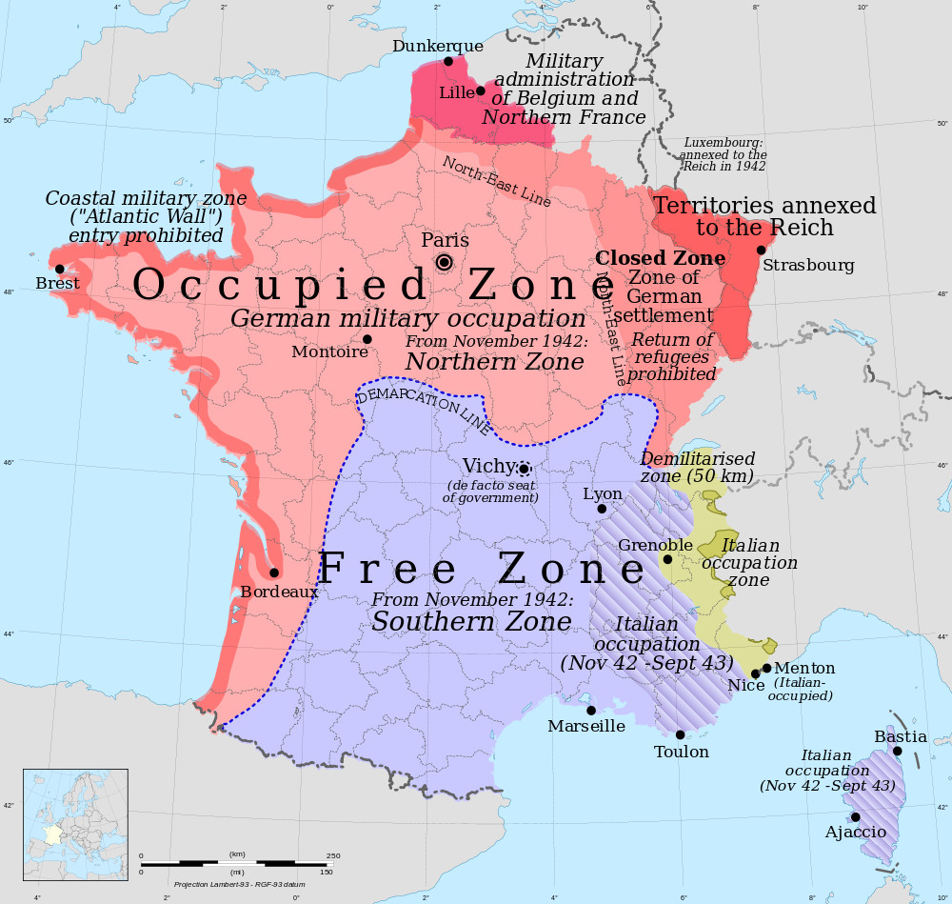

Slide 8
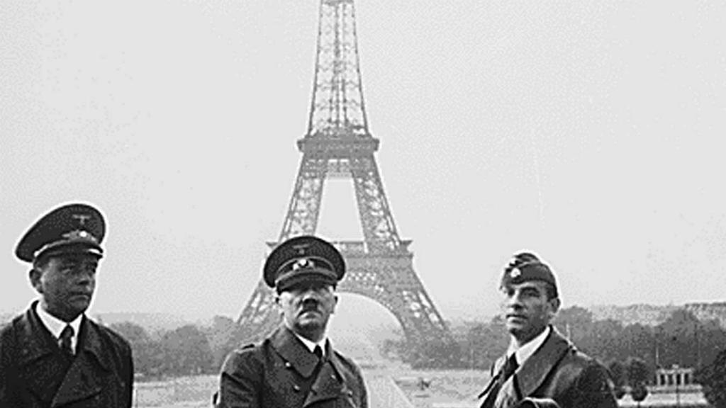

Slide 9
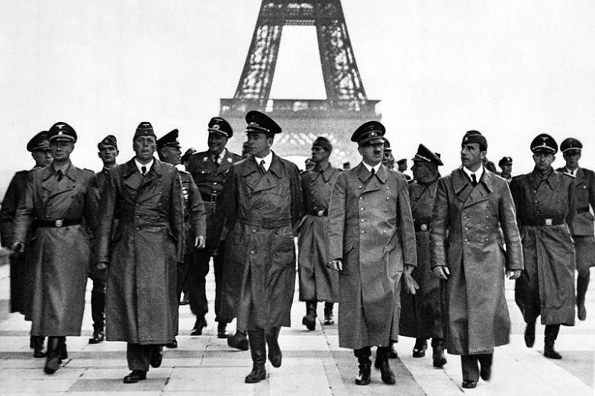

Slide 10
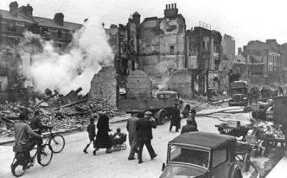
The Battle of Britain
Started on July 10th, 1940
After Germany and Hitler had conquered most of Europe, including France, the only major country left to fight them was Great Britain.
Germany wanted to invade Great Britain, but first they needed to destroy Great Britain's Royal Air Force.
The Battle of Britain was when Germany bombed Great Britain in order to try and destroy their air force and prepare for invasion.
A bombed London street

Slide 11
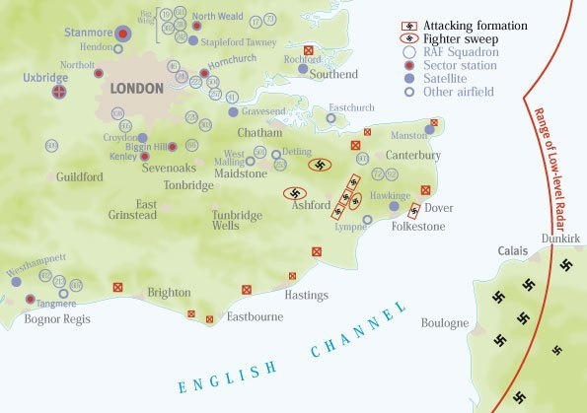

Slide 12
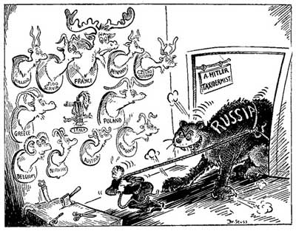
Operation Barbarossa
Under the codename Operation "Barbarossa," Nazi Germany invaded the Soviet Union on June 22, 1941.
Went against the Soviet-Germany Non-Aggression pact of1939.
The seizure of prime land within Soviet borders for long-term German settlement had been core policy of the Nazi movement since the 1920s.
The Nazis were also firmly against Communism.

Slide 13
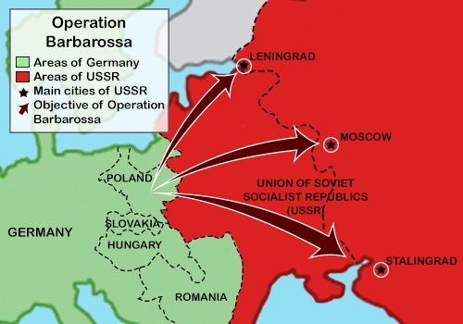

Slide 14
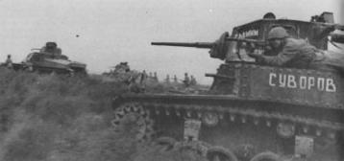
Battle of Stalingrad
Late 1942 and early 1943.
The Luftwaffe, bombed the Volga River and the then the city of Stalingrad.
A turning point in the war. After losing the battle, the German army lost so many soldiers and took such a defeat that they never quite recovered.
A major industrial and communications centre for the Soviet Union in the south.
Also, it was named after the Soviet leader Josef Stalin.

Slide 15
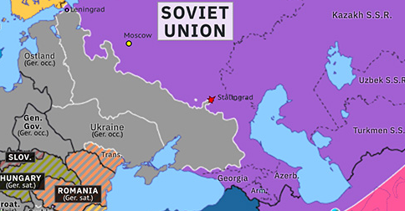

Slide 16
The Final Solution
On January 20, 1942, Reinhard Heydrich, the chief of Germany’s Security Police, held a secret meeting known as the Wannsee Conference. Leading police and civilian officials discussed the continuing implementation of the "Final Solution.“
It is unclear when exactly Hitler decided to murder Europe’s Jews. The decision was probably made sometime in 1941, with the invasion of the Soviet Union.
The Nazi leaders envisioned killing 11 million Jews as part of the “Final Solution.” They succeeded in murdering 6 million.
Special group of SS soldiers – Einsatzgruppen – were sent to murder all the Jews they could, by the end of 1941 about 500,000 Jews had been shot.
Death camps were built in Poland, far away from Germany - Auschwitz

Slide 17
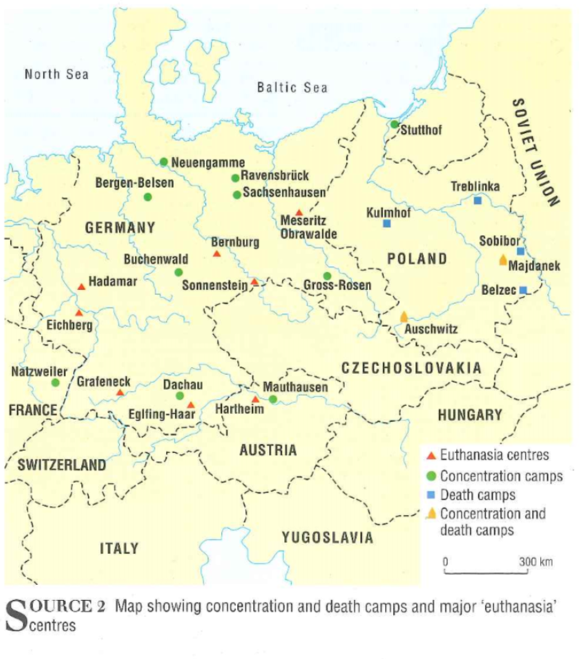

Slide 18
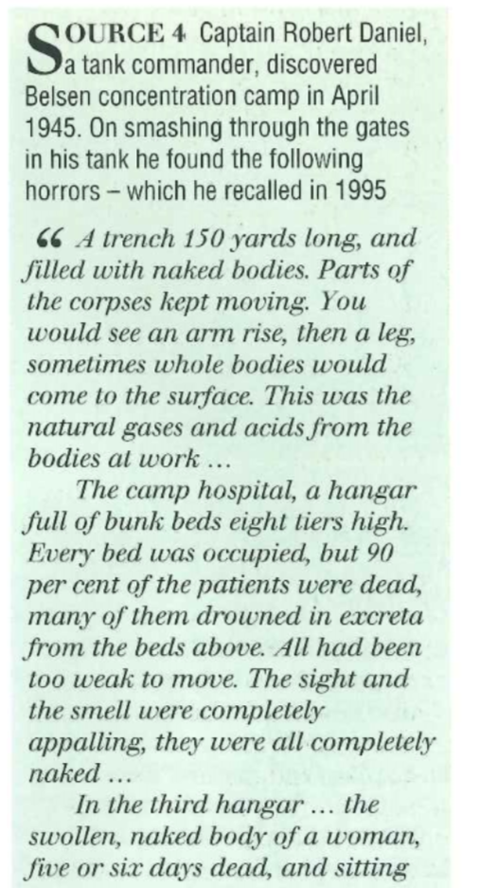
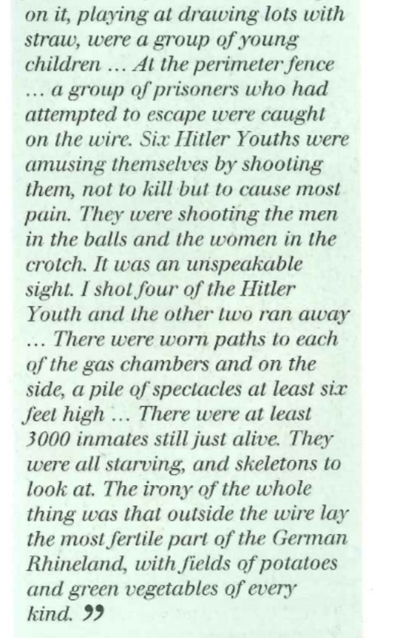

Slide 19
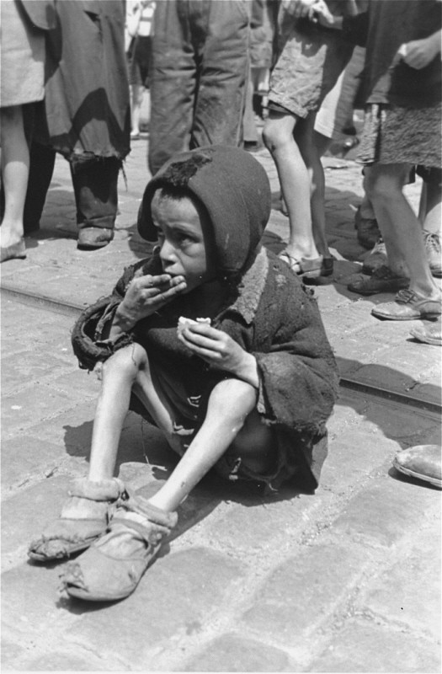
A destitute child in the Warsaw ghetto
An emaciated child eats in the streets of the Warsaw ghetto. Warsaw, Poland, between 1940 and 1943.

Slide 20
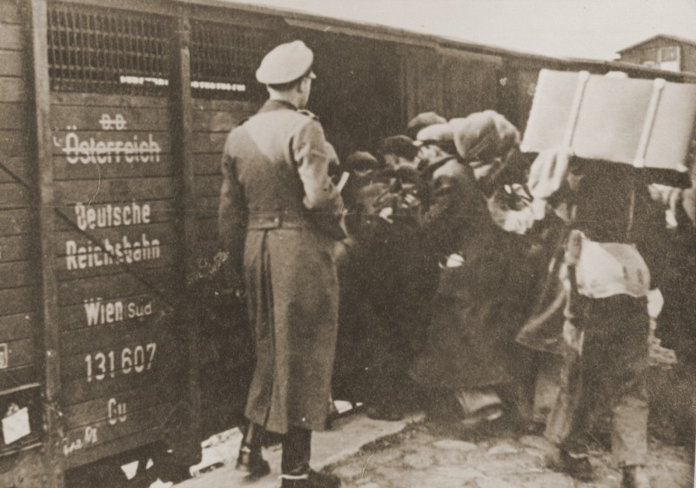
Deportation to Belzec
Jews are forced into boxcars for deportation to the Belzec killing centre. Lublin, Poland, 1942.

Slide 21
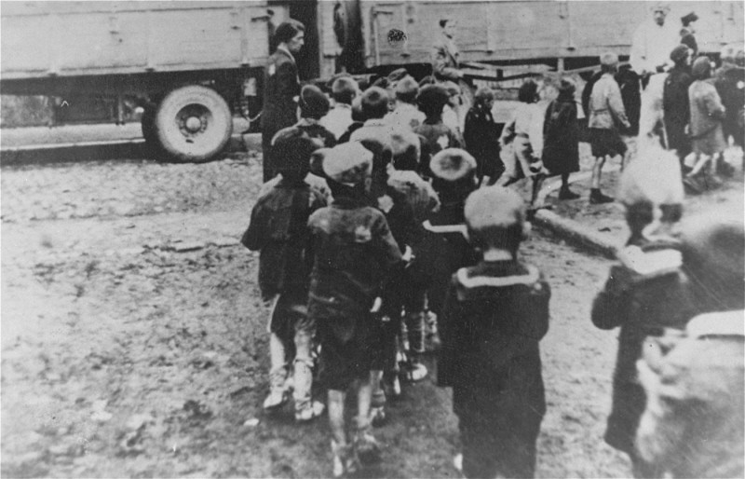
Deportation of Jewish children from the Lodz ghetto
Deportation of Jewish children from the Lodz ghetto in German-occupied Poland during the "Gehsperre" Aktion, September 1942.

Slide 22
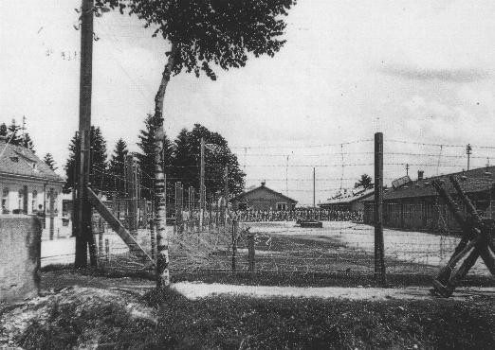
Early view of the Dachau concentration camp
An early view of the Dachau concentration camp. Columns of prisoners are visible behind the barbed wire. Dachau, Germany, May 24, 1933.

Slide 23
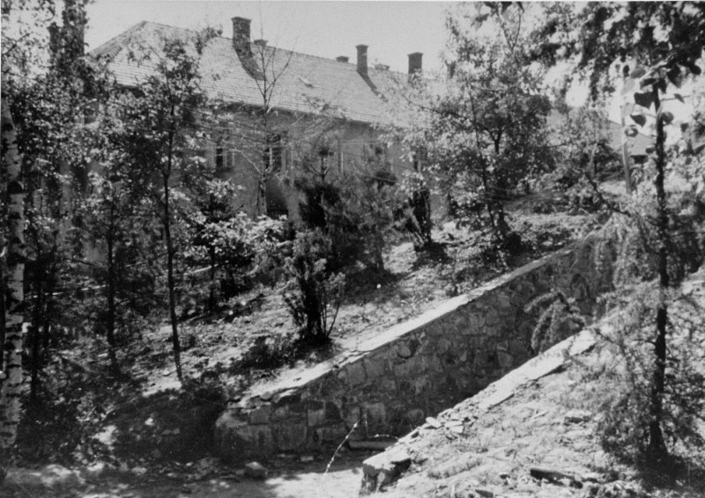
Entrance to the gas chamber in Auschwitz
The entrance to the gas chamber in Auschwitz, where Zyklon B was tested on Soviet prisoners of war. The building in the background is a hospital for SS members. Auschwitz, Poland, date uncertain.

Slide 24
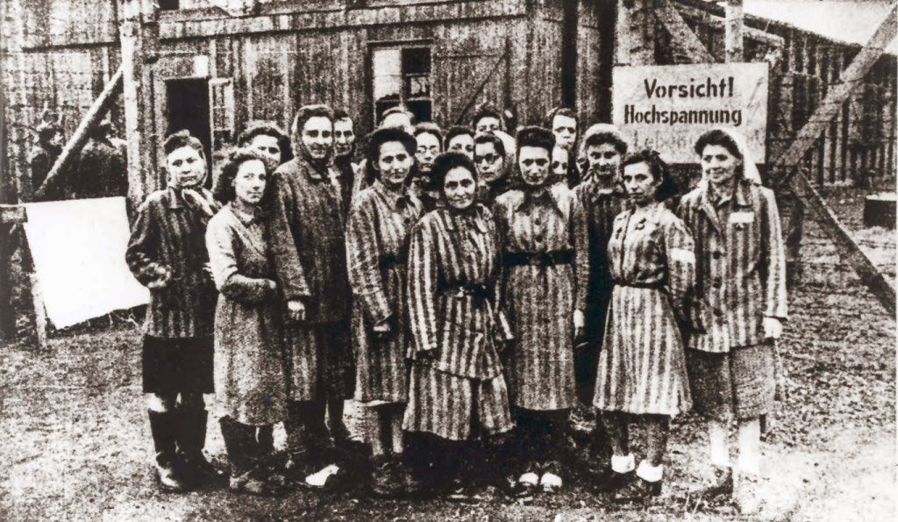
BLANKA ROTHSCHILD DESCRIBES FORCED LABOR IN THE RAVENSBRÜCK CAMP
https://encyclopedia.ushmm.org/content/en/oral-history/blanka-rothschild-describes-forced-labor-in-the-ravensbrueck-camp?parent=en%2F2689

